Slide 1


Engaging Community Based Organizations in Health Information Exchange
Dominique Gabriel, PCMH CCE, Matthew Gannon, PCMH CCE
Janice Magno, MPA, PCMH CCE
NYC Dept of Health and Mental Hygiene | NYC REACH
October 25, 2023

Slide 2
Learning Objectives
At the conclusion of this session, learners will be able to:
Identify key characteristics of Community Based Organizations (CBOs) most likely to benefit from Health Information Exchange (HIE)
Understand workflows and skills important to HIE technical integration
Describe use cases in which HIE improves CBO efficiency and ability to coordinate care with health care providers

Slide 3
Agenda
About NYC REACH
Health Information Exchange (HIE) Landscape
CBO Project Overview
CBO Engagement
Implementation
Lessons Learned

Slide 4
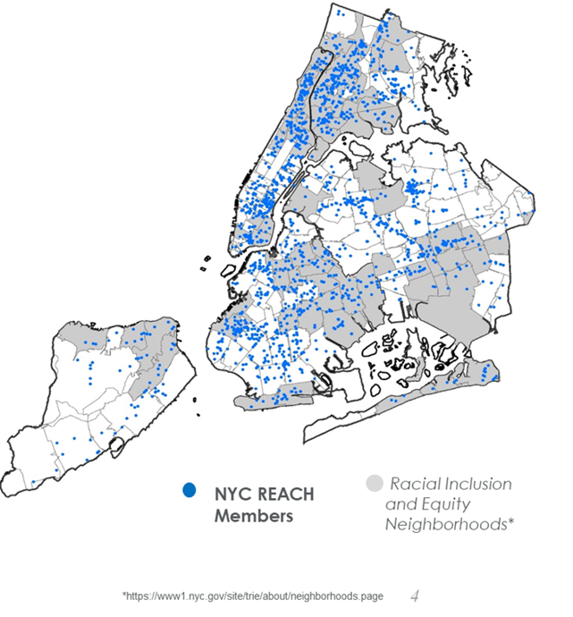
About NYC REACH
NYC REACH is a provider support organization in the Bureau of Equitable Health Systems at the New York City Department of Health and Mental Hygiene.
Our goal is to support safety-net providers in delivering high quality, person-centered, and coordinated care for populations in marginalized neighborhoods. Services are at no cost to the providers.
Founded in 2010 as a Regional Extension Center by HHS, to serve as Health IT resource and trusted partner to NYC safety net providers.

Slide 5
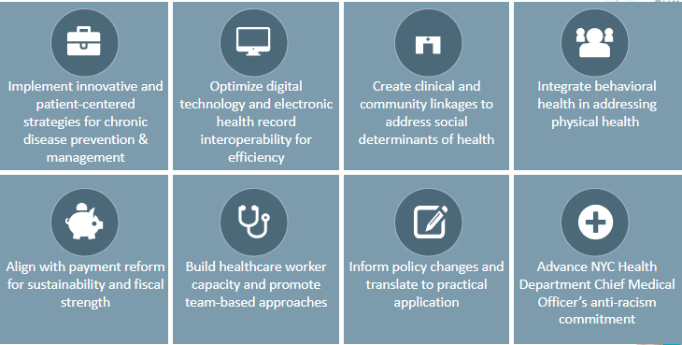
NYC REACH Programs

Slide 6
Health Information Exchange
The use of Health Information Exchange (HIE) improves the quality of care. NYC REACH supports providers to implement HIE through:
  Training and education
  Incentive and subsidy programs
  Technical assistance
  Practice transformation
Currently, over 900 NYC REACH member practices are connected to HIE.

Slide 7
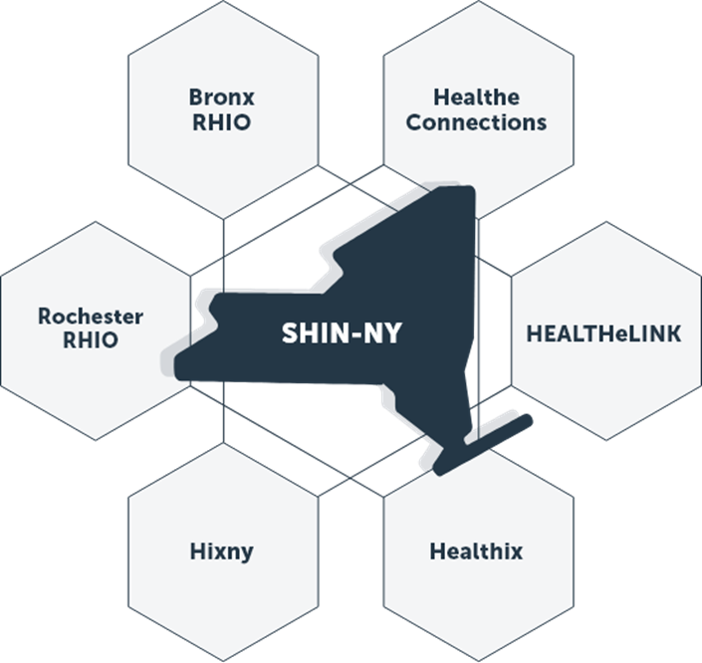
HIE in New York State
NYS has six local Regional Health Information Organizations (RHIO), which connect to each other through the Statewide Health Information Network (SHIN-NY) to share health data statewide.
The majority of RHIO participants are healthcare providers
  Hospitals
  Federally Qualified Health Centers
  Primary Care practices
Notes:
I'm going to give some information on the landscape of HIE in NYS
We have regional, state-funded, state-regulated – but independent – non-profit HIEs
In our region we have two
Favorable landscape in NYS. And investment in things like SHIN-NY.
Critical mass of medical providers – as well as others like payers, labs, BHOs – all of which submit data, creating this centralized hub of information. Amazing MPI work.
What's in each of these HIEs? Will get to that in a moment, but – all the basic clinical data
And it's free!
Been favorably received by NYS healthcare folks (I mean – you know how technoligy goes)

Slide 8
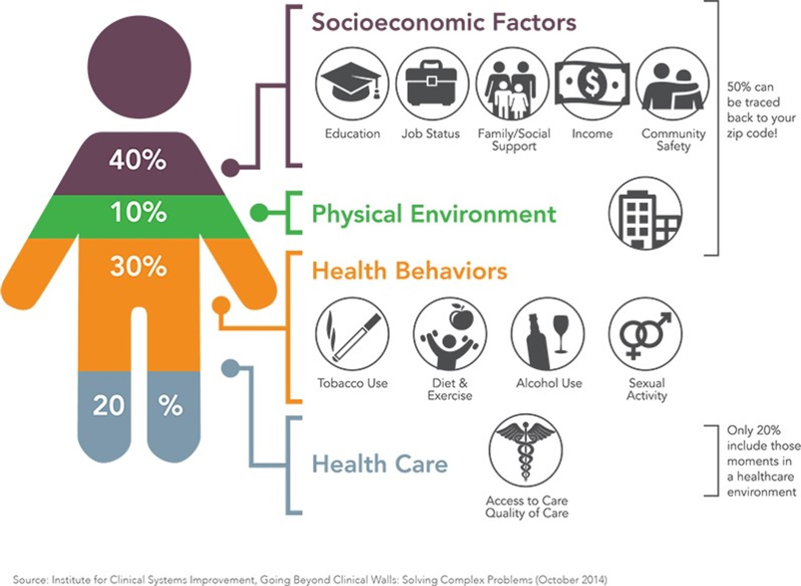
Health-Related Social Needs
80% of one’s health
outcomes are related to socioeconomic and behavioral factors; however, CBOs that address these factors have limited access to health information
Notes:
But what about social care?
Let me tell you about NYC social care...
I was hoping to come with deep statistics – there aren't so many great p ublic recorded ones. Like 535 food pantries, 200 organizations serving immigrant populations, about 100 serving patients with hiv
Software – different from what we're used to. Systems themselves not designed to maintain PHI. Funding – different from wat we're used to.
We've been doing projects to give them tools: UU, etc.
So many can benefit from health information.
For 1115 waiver they are a lot of the crux

Slide 9
CBOs and HIE
In NYC, most CBOs have not participated in HIE.
HIEs originally designed around needs of medical care providers
HIEs traditionally required participants to use Certified Electronic Health Records (EHR) to integrate
Most CBOs ineligible for previous NYS incentive funding for connecting to HIE
Many CBOs lack familiarity with privacy and HIPAA requirements
Notes:
Give examples of kinds of CBOs in NYC. They provide a wide variety of services, ranging from X to Z. We are fortunate to have many great CBOs in NYC. All sizes – large organizations and small. All typically bandwidth and resources strapped.

Slide 10



Benefits of HIE for CBOs
Clinical Lookup
Clinical data from NYS & NYS providers to monitor clients' medical conditions
Alerts
Admit/discharge notifications to support post-discharge care transitions
Data/Analytics
Panel reports to prioritize CBO outreach to patients and support program evaluation
10

Slide 11



Project Overview
Beginning in December 2020, NYC REACH collaborated with Healthix to pilot HIE integration among a cohort of CBOs
Partnered to refine Profile360 feature for CBOs
Engaged 10 CBOs in New York City to integrate with Healthix at no cost
Provided technical assistance for onboarding and implementation processes
Notes:
This was the 'coming together of worlds'

Slide 12

About Healthix
Largest public HIE in US, serving NYC & surrounding region
Exchanges data with over 8k facilities, for 20M+ individuals
Services include:
  Query: web portal to look up clinical information
  Alerts: real time notifications of admissions and discharges
  SHIN-NY: access to statewide patient health information
  Analytics: reporting services for population health, research, outreach
  Profile 360: data exchange for CBOs

Slide 13
Patient Data Available in Healthix
Demographics (Name, Gender, DOB, Race, Ethnicity, Language)
Smoking Status
Vital Signs (height, weight, BP, BMI)
Immunizations
Allergies
Medications
Problem List
Lab Tests/Results
Care Plans
Procedures
Care Team
Core Data Set
  Alerts:
  Emergency Admit/Discharge
  Inpatient Admit/Discharge
  Death

Slide 14



Integration and Data Flow
Healthcare Facilities
Pt Demographics, Consent
Clinical Data, Alerts
Pt Demographics, Consent
Community Based Organizations
Clinical Data, Alerts

Slide 15
Implementation
CBO Engagement
Identify CBOs & conduct outreach
Planning
Conduct Project Kickoff with each CBO
Onboarding
Train end users
Sign agreements
Complete Compliance Packet
Technical Integration
Set up and train on flat file
Test secure file transfer
Activate Healthix portal
Begin live transfer of data
Design consent workflows
PDSA workflows
Notes:
The implementation process was divided in 4 phases
First phase: CBO engagement. I defined what organizations would be ideal but I'll discuss what the outreach process looked like
Second Phase was planning: Orienting the CBOs on what services they would receive being a Healthix partner and providing an overview of the implementation timeline during this process, CBOs would also complete their compliance packet and consent workflows
Third Phase: Technical Integration: The steps needed for CBOs to establish a connection with Healthix
Fourth Phase: Onboarding – This phase would see users trained, the data transfer of actual patients, and the ongoing support of CBOs with their use of Healthix.
Slightly less detail)

Slide 16




Identifying CBOs
We developed criteria to identify CBOs for the pilot. The CBOs we targeted:
Serve communities in NYC's Taskforce for Racial Equity (TRIE) priority neighborhoods
Provide services that benefit from the use of HIE (e.g. care management)
Are covered entities under HIPAA (furnish health services and/or bill insurance)
Use an electronic system to track client information
Notes:
As mentioned by Matt earlier – we know there would be benefits to CBOs using Healthix. Sustained interest was vital In our efforts to determine which organizations (CBOs) would best benefit from using Healthix we wanted to categorize the following:
We did not have the network already that provided a specific set of services. The process itself took time, we had a list of 100s of CBOs across Healthix and NYC REACH programs (Public Health Service Corps NowPow/UniteUs) that we had no relationship with and the criteria.
Was not easy to find 10 at ALL
CBOs support that support under-resourced communities. (Include a sentence as a part of our DOHMH Health Equity mission
Of CBOs that support under-resourced communities, would the services they provide benefit from using Healthix? Meaning did they provide health services, chronic care management, social services
A food pantry may not benefit from looking a client's lab result but a CBO with a diabetes self-management program where they provide education
Third, were they a covered entity? Did they bill for insurance, provide health services, or have business associate agreements with other vendors? Naturally, if they provided services that would benefit from the use of Healthix, most likely they are
Lastly, we wanted to offer the opportunity to CBOs that did not have an EH.R but still used an electronic system to track clients and client information for other internal and state programs. Since the process of HIE integration is manual, there would be an advantage for the CBO to have the technical capabilities to use Healthix
With the focus on impact and equity, the hope was to find CBOs that remain both interested and engaged.

Slide 17
CBO Engagement
Identified 50 CBOs that met criteria
Conducted phone & email outreach; warm handoff if possible
Invited to group & individual info sessions
Completed Healthix agreement to move to next phase
Notes:
Theme: It took longer for folks to see this it was very conceptual and once the we got one CBO to sign up
Points: Healthix was refining their tool – as we were implementing their 4 phases which made it hard for CBOs to conceptualize the product
We started with a very large list comprise programs of our network of CBOs with various criteria and tiers. Some were a good fit, some were not,
Stress the effort behind explaining Healthix to CBOs who have no background knowledge
During our recruitment, each CBO we engaged received a call. NYC REACH facilitators contacted 50 CBOs over the course of 2 months. Some were cold calls to organizations we did not have a prior relationship with and others were organizations in our existing REACH programs. Many organizations I had to call many more than twice due to the availability
Of the 50 organizations, 30 had shown initial interest in connecting( interest was defined as wanting to learn more about Healthix or wanting to proceed forward with integration).
We invited about half of these organizations to a joint kickoff session presented by both NYC REACH and Healthix to discuss the Health Integration Product, how the product could directly benefit their CBO, and how to complete the Healthix agreement form to begin the planning and eventual implementation phase of Healthix.
Separate one-on-one sessions were conducted with CBOs who showed interest but were unable to attend the group session. In total, we had about 8 CBOs attend group sessions and 4 organizations attend one-on-one sessions

Slide 18


Planning
Kickoff
Discussed project plan and project timeline
Defined respective roles of NYC REACH, Healthix, and CBO
Identified CBO project leads
Compliance
Reviewed and completed compliance plan
Confirmed CBO's HIPAA Covered Entity status
Designed workflows to capture client consent
Notes:
Of the 12 organizations that had attended a session, we had our initial 10 who agreed to integrate a Health Information Exchange.
Why is HIPAA compliance so important you are having access to state client information
Planning meetings were then scheduled with CBOs to lay out the project plan and timeline. Because the integration process was manual and did not involve EHRs or their vendors, the timeline would be closer to 9-12 months vs 3 months. (?)
Included in these discussions were the roles of each party involved.
What are the IT leads if there are none? What did you
NYC REACH would be the main point of contact for general questions on Profile360 including project scope, general information, goals, and expectations of CBOs
Healthix would lead the compliance and technical integration process.
..and CBOs would define their internal roles such IT point of contact, the project leads, departments that would use Profile360, and their role in completing all tasks as defined in the timeline
CBOs would then need to complete which included reviewing and understanding the terms of compliance. Confirming/Reconfirming their status as a covered entity, and designing workflows to capture patient consent.

Slide 19
Planning Considerations
CBOs may be unclear on HIPAA Covered Entity Status
  Required to access RHIO portal and receive alerts
  Prioritize recruitment of covered entities & confirm eligibility to sign Business Associate Agreement (BAA)
CBOs less likely to have HL7 Object Identifier (OID)
  Each HIE participant needs an OID to uniquely identify the CBO to others on the HIE
  Medical providers usually have already (from EHR vendor); we found CBOs did not
  There is a cost to obtain an OID – remember to budget
CBOs may be less exposed to authentication requirements
  Portal access required multi-factor authentication
  Work phones and work emails required – not all CBO staff had these
Notes:
The planning phase did present unique compliance considerations for CBOs that may not normally exist for the more common users of Healthix, Healthcare Partners, and Facilities.
We found that in both the information and compliance sessions. CBOs were not always clear on what it meant to be a covered entity although the services they provided would qualify them as a covered entity. This often meant sometimes they did not know what documentation they needed to provide such as a BAA. The caveat here as well was that Healthix would not provide full access without the organization being a covered entity. This included limited access to the Healthix portal
Since we also identified mostly CBOs that did not have an EH.R it meant that were not likely to have an Object Identifier (OID) which are used to uniquely identify organizations. Typically, HER vendors would have a practices OID and assign them one, but since the CBOs did not, it meant they needed to purchase one. There is a fee to register an OID with Hl7 which can range from 250 dollars to 500 dollars depending on member status. However, Healthix did cover the cost of all 10 CBOs OID's. I remind folks here to budget for OIDs when dealing with organizations that do NOT have an EH.R. If you do deal with CBOs that have EHRs, ask for their OID
Lastly for organizations that deal with sensitive client information protections are in place to secure that data. CBOs will be asked not to use personal phones or personal emails. Healthix provides real-time alerts that go directly to a user's phone. So it will be necessary that someone in the organization has both a work phone and work email address. Some CBOs did not have this

Slide 20
Planning Consent Workflows
Consent required from every client to get any info from portal, files, alerts
Most common CBO workflow was to have client sign on paper – at intake for new clients, ad hoc for established clients
Required to retain consent; subject to audits from RHIO
CBOs found this easy to implement, likely due to smaller population and smaller program size, experience with consents
Notes:
As for consent – Healthix provides a grant or deny consent form that should be completed for all clients for non-emergency providers. Even if a patient denies, that must be indicated so on the consent form. Lastly, the form needs to be completed in person and signed with a wet signature.
I did find that most CBOs had no issue with developing workflows for client consent because they had already done so for other programs. So it was a matter of integrating Healthx compliance forms and developing easy-to-understand talking points to explain the purpose of Healthix and how it supports client care
The important reminder for CBOs, however, was retaining all consent. RHIOs conduct annual audits, so you need a physical and electronic copy of client consent on file at all times. “Healthix Consent” or file a hard copy of consent form(s) in the patient’s chart – whichever method your organization chooses.
Designing consent workflows should be something facilitators find the least amount of time to support CBOs with. They normally have experience with consent forms and the size of their population or program typically makes this a non-hassle

Slide 21
Integration and Data Flow
Healthcare Facilities
Pt Demographics, Consent
Clinical Data, Alerts
Pt Demographics, Consent
Community Based Organizations
Clinical Data, Alerts
Notes:
Now as mentioned earlier data flow for CBOs and Healthcare Facility will look different. The process for retrieving data (along with the data processing itself) will be automated through EHRs. The clinical and demographic information will exist in the patient progress notes and all it will take is a click of the button in the Healthcare Facilite's EH.R for that to transfer that information right to Healthix
CBOs will have to do this differently, to retrieve their client data. They will need to submit a completed mass Flat file with selected client information to have that information present in both the Healthix portal and retrievable as an excel file

Slide 22
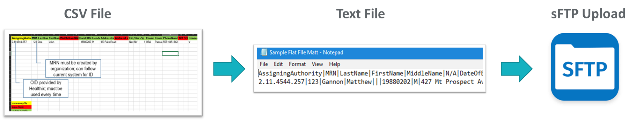
Technical Integration - Setup
Collaborated with CBOs to generate client demographics and client information:
  Input patient information into CSV file
  Convert CSV into pipe-delimited text file
  sFTP file credentials shared with CBO
  Upload text file to sFTP
Notes:
Technical integration was probably the most unique portion project. Some of the CBOs we worked did not have the technical capabilities to confidently engage in the integration process. This included both terminology and grasping each individual step.
BIG THEME: Get this file right, if the patient is not listed there it won't go through ( We have real life stories; folks were nervous)
We needed to deconstruct the process to its simplest form by trying to reduce the complexity and burden of the process as much as possible.
Technical Integration was broken up into 3 parts: Creation (client file creation); Validation and Testing, and Retrieval
Creation involved multiple steps: First was identifying all patients who had completed their consent between the planning phase and now and having them documented in an excel file. To make this process easier, we decided to create a CSV file template (that you see here) that instructed CBOs which columns should be pre-filled, did not require information, or needed to be completed as marked by their color code. Here client would document all the information including the client's grant or deny consent.
Next, the CSV Excel File would need to be turned into a text file. Again as you might imagine, not every CBO was aware of what that meant or how it was done. For this step NYC REACH and Healthix met with CBOs one-on-one to train folks on how to make this conversion along with a detailed step-by-step process written out for them post-meeting. The text file would serve as the submission file that CBOs would upload
Finally, CBOs needed to download a secure File Transfer Portal client. This could be downloaded for free online. All Healthix needed to do was provide the credentials needed to connect the sFTP portal to theirs. During the same training, Healthix would guide CBOs on how to upload the text file to the sFTP portal. The outcome was for Healthix to retrieve the text file manually and then upload in their Healthix servers so patients (who consented to having their information made available in Healthix) could be looked up in the Healthix portal by their CBOs
During the validation and testing process – Healthix wanted to ensure the CSV files translated correctly into their servers. If there were any problems with the CSV file, Healthix would notify the CBO and sometimes ask that they submit a new text file
Once validated – client information would be made available in Healthix and CBOs could also retrieve a mass file of all patients they have submitted via sFTP from the sFTP which would include updated information on diagnosis, labs, vaccines, and last date of encounters
BIG THEME: Get this file right, if the patient is not listed there it won't go through ( We have real life stories; folks were nervous)

Slide 23
Technical Integration – Ongoing Maintenance
Monthly Uploads: CBOs must upload CSV files at least once a month to maintain patient files.
Weekly Downloads: Files uploaded every Monday via sFTP. CBOs must pull Profile 360 client data files
Quality Assurance: Healthix to verify periodically that information is being properly shared in client data files
Notes:
Post-upload we encourage Healthix participants to continue t monthly uploads of CSV files. Because there is no quality dashboard, we want to track usage based on when users last accessed the sFTP file. This includes weekly downloads of updated CSV files shared by Healthix
Weekly downloads

Slide 24
Onboarding
User Navigation Training
Healthix Consent Training
Client/Patient file creation and upload training
Notes:
The final phase is onboarding. Once the sFTP connection is established and sFTP files are confirmed Users will complete User navigation training embeeded in Healthix. This includes how to interpret and navigate different features such as Healthix alerts, patient records, discharge summaries, and so on so forth. Both user navigation training and consent training are necessary for users to actually use Healthix
Additionally, we will continue to provide csv file creating and uploading training for any interested staff

Slide 25
Lessons Learned
CBO Engagement
Refine and test messaging for use cases
Conduct brief assessment with prospective CBO partners
Maintain continuous engagement throughout
Planning
Anticipate less CBO experience with HIPAA requirements
Have each CBO set a goal for this project to prevent loss of momentum
Technical Integration
Work with vendor to simplify technical language
Assess CBO staff technical knowledge
Ensure training is in place to address tech knowledge gaps
Onboarding
Create plan for post-live support (check-in calls, etc.)
Consider group facilitation once CBOs live, to share best practices
Notes:
Throughout this project, there were many challenges we faced: staff bandwidth(caused by COVID-19), familiarity with both HIPAA and knowledge required for set-up, and constant downtime

Slide 26

Current Status
All CBOs live on Healthix and continue to submit regular client demographic & consent files
CBOs using Healthix portal's Query function to access health information of their clients
CBOs have operationalized Healthix Alerts
Examples:​
  Hospital discharge alerts to follow up with clients who have serious mental illness​
  Hospital/ED admission alerts to monitor re-entry and drug treatment clients​
  Tracking client a1C results for chronic care management programs
Raising Health
Haitian Community Coalition
CASES
Mexican Coalition
Exponents
Goddard Riverside
The Bridge
FACES
MIH Experience
Independence Care System

Slide 27

CBO Feedback
"We turned on alerts recently and have found them very helpful for locating our hard-to-find clients especially when they’re in the ER."
"The clinic staff have access to information from hospitals that was previously very difficult to get."
"Access to Healthix supports diagnosis when the client's presentation is very complex or unclear from the information shared by the client."

Slide 28



Key Takeaways
Including CBOs in HIE improves quality of care and can improve health outcomes
To successfully implement HIE for CBOs, robust technical assistance and facilitation is required
Funding is needed to build and improve CBO technology capacity and staffing

Slide 29
Next Steps
Continue collaboration with Healthix to streamline data exchange process & track utilization
Continue to engage CBOs in optimizing workflows and in quality improvement
Hold learning collaborative that will bring all CBOs together to share best practices
Prepare for larger scale rollout of HIE to CBOs in anticipation of upcoming NYS Medicaid waiver

Slide 30
Questions?

Slide 31
Thank You!

